Slide 1

Regularization techniques
L1 and L2 Regularization
By - Chhanak Tank
Manas Ganti

Slide 2
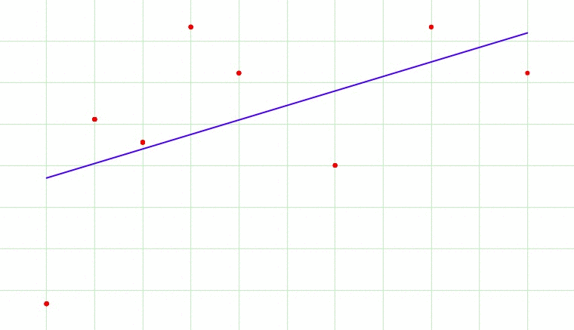
Regularization
In supervised machine learning, models are trained on a subset of data aka training data. The goal is to compute the target of each training example from the training data.
Now, overfitting happens when model learns signal as well as noise in the training data and wouldn’t perform well on new data on which model wasn’t trained on.
In the example below, you can see underfitting in first few steps and overfitting in last few.

Slide 3
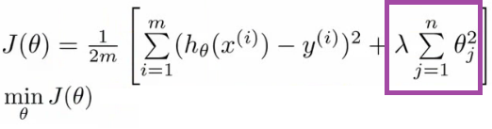
Now, there are few ways you can avoid overfitting your model on training data like cross-validation sampling, reducing number of features, pruning, regularization etc.
Regularization basically adds the penalty as model complexity increases. Regularization parameter (lambda) penalizes all the parameters except intercept so that model generalizes the data and won’t overfit.
In above gif as the complexity is increasing, regularization will add the penalty for higher terms. This will decrease the importance given to higher terms and will bring the model towards less complex equation.

Slide 4
RIDGE REGULARIZATION (L2)

Slide 5
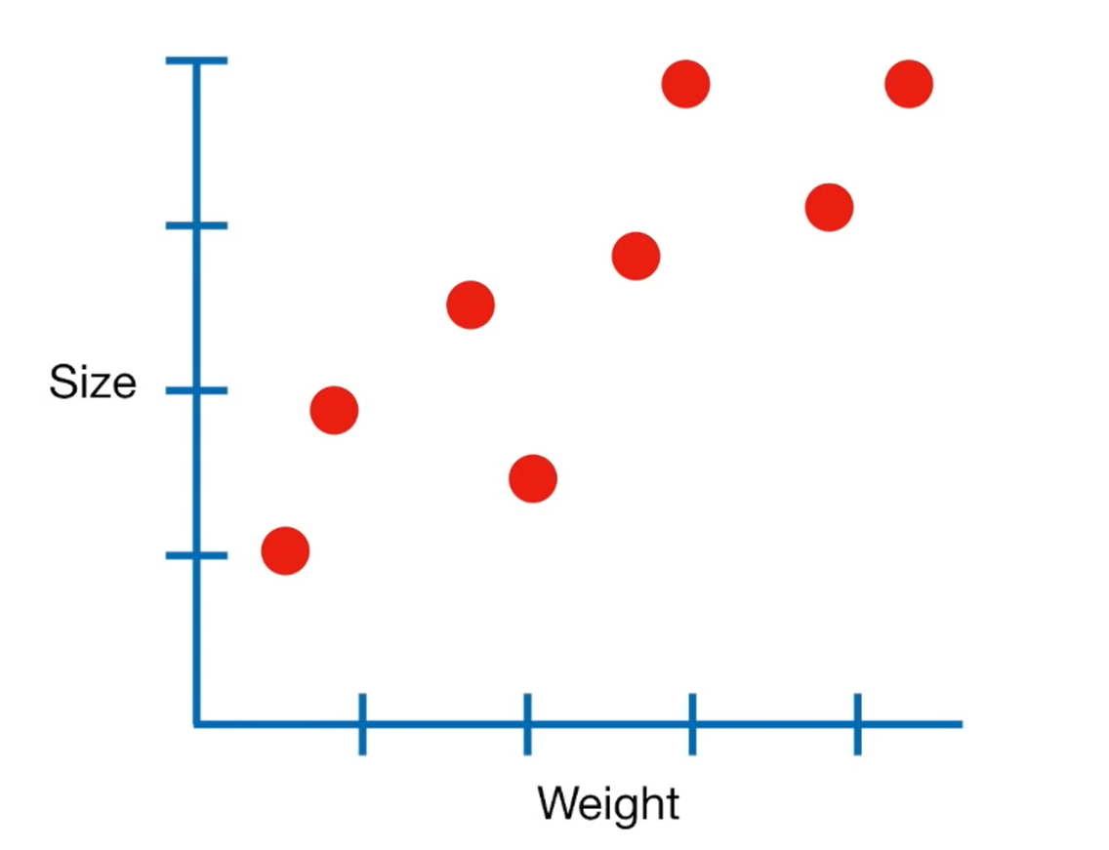
RIDGE REGULARIZATION (L2)
Let’s start by collecting weight and size measurements from bunch of mice.
Since these data look relatively linear, we will use Linear Regression , AKA Least Squares, to model the relationship between weights and size.

Slide 6
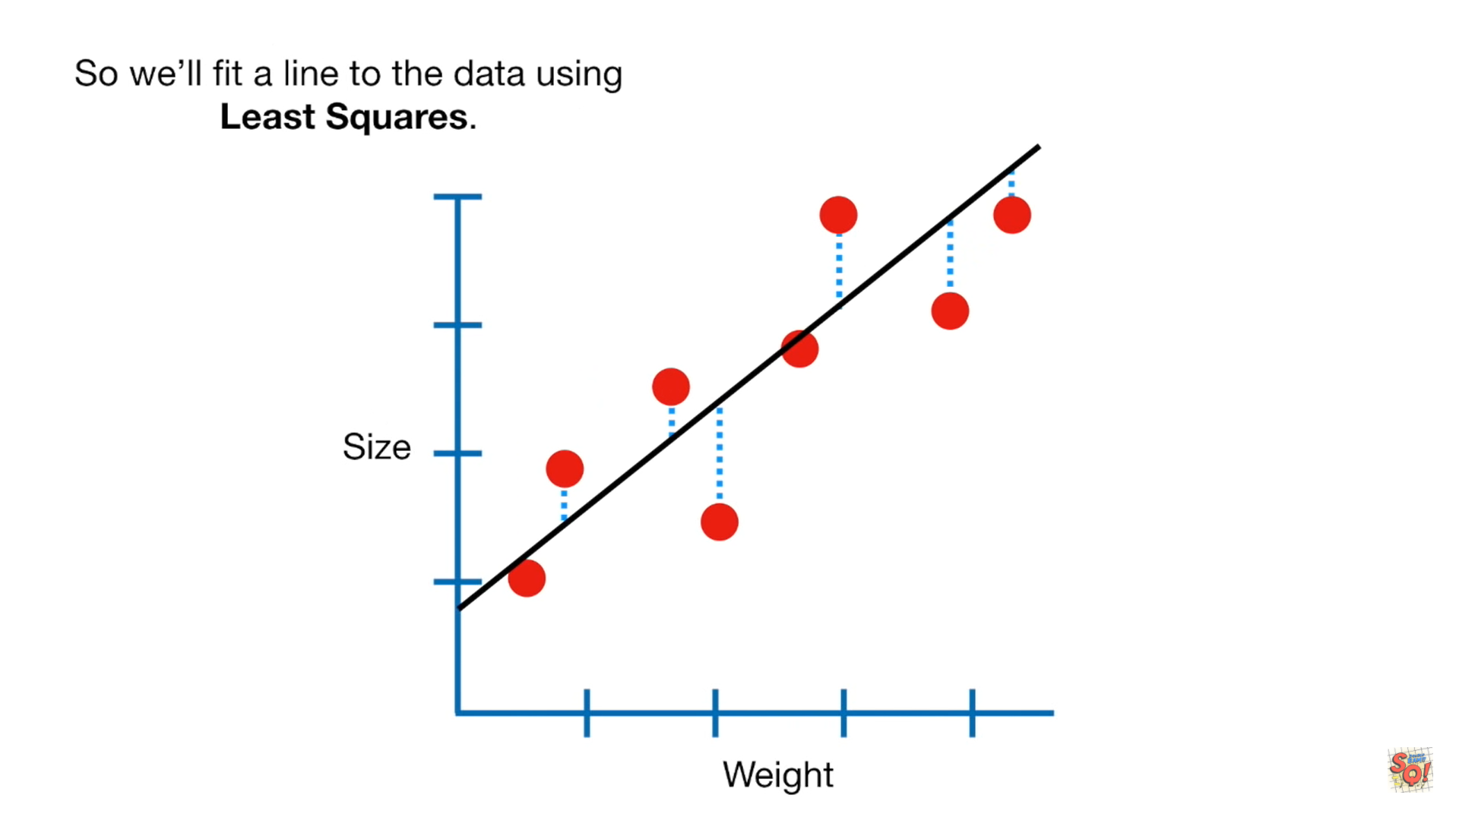
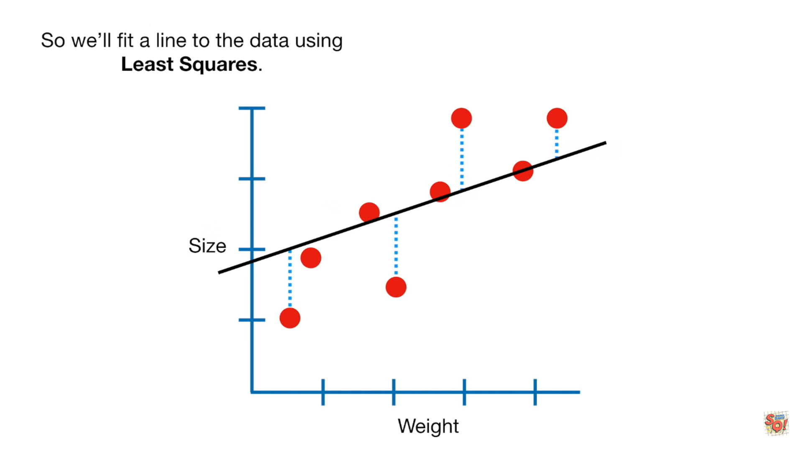
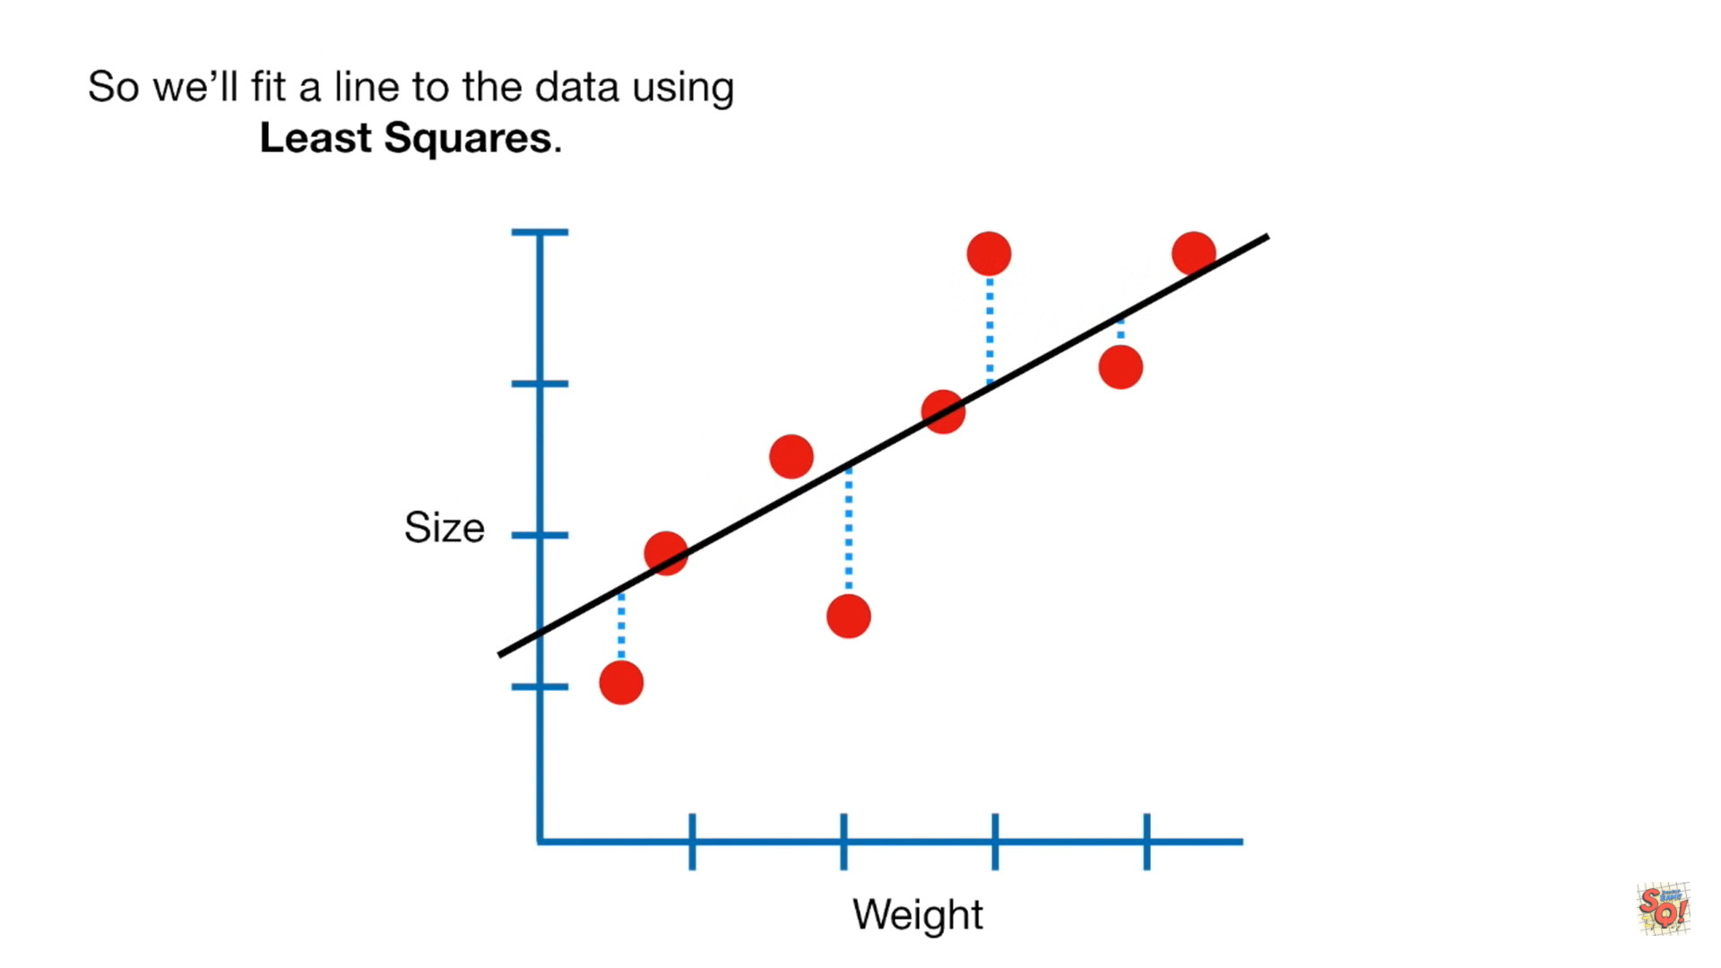
So we’ll fit a line to the data using Least Squares.

Slide 7
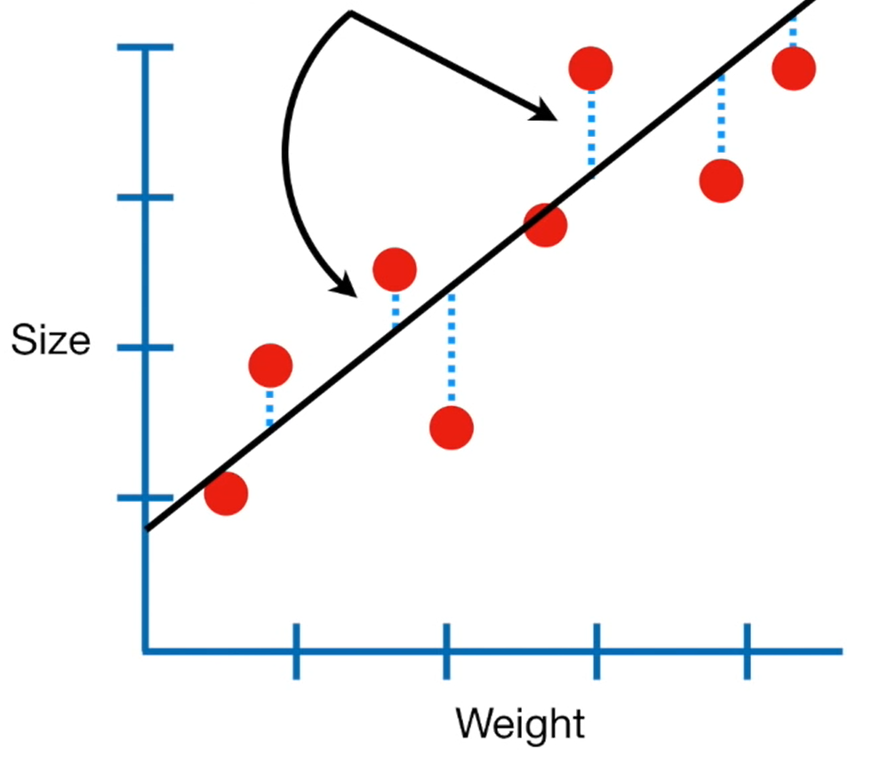
In other words, we find the line that results in the minimum sum of squared residuals.

Slide 8
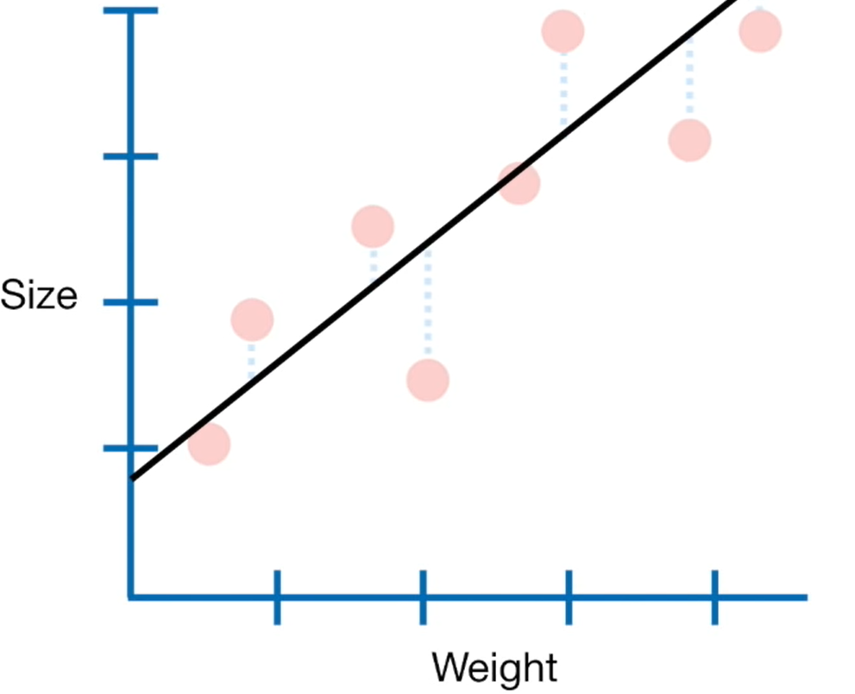
Ultimately, we end up with this equation for the line:
Size = 0.9 + 0.75 x Weight
Y-axis intercept
Slope
The line has two Parameters :
Y-axis intercept
Slope

Slide 9
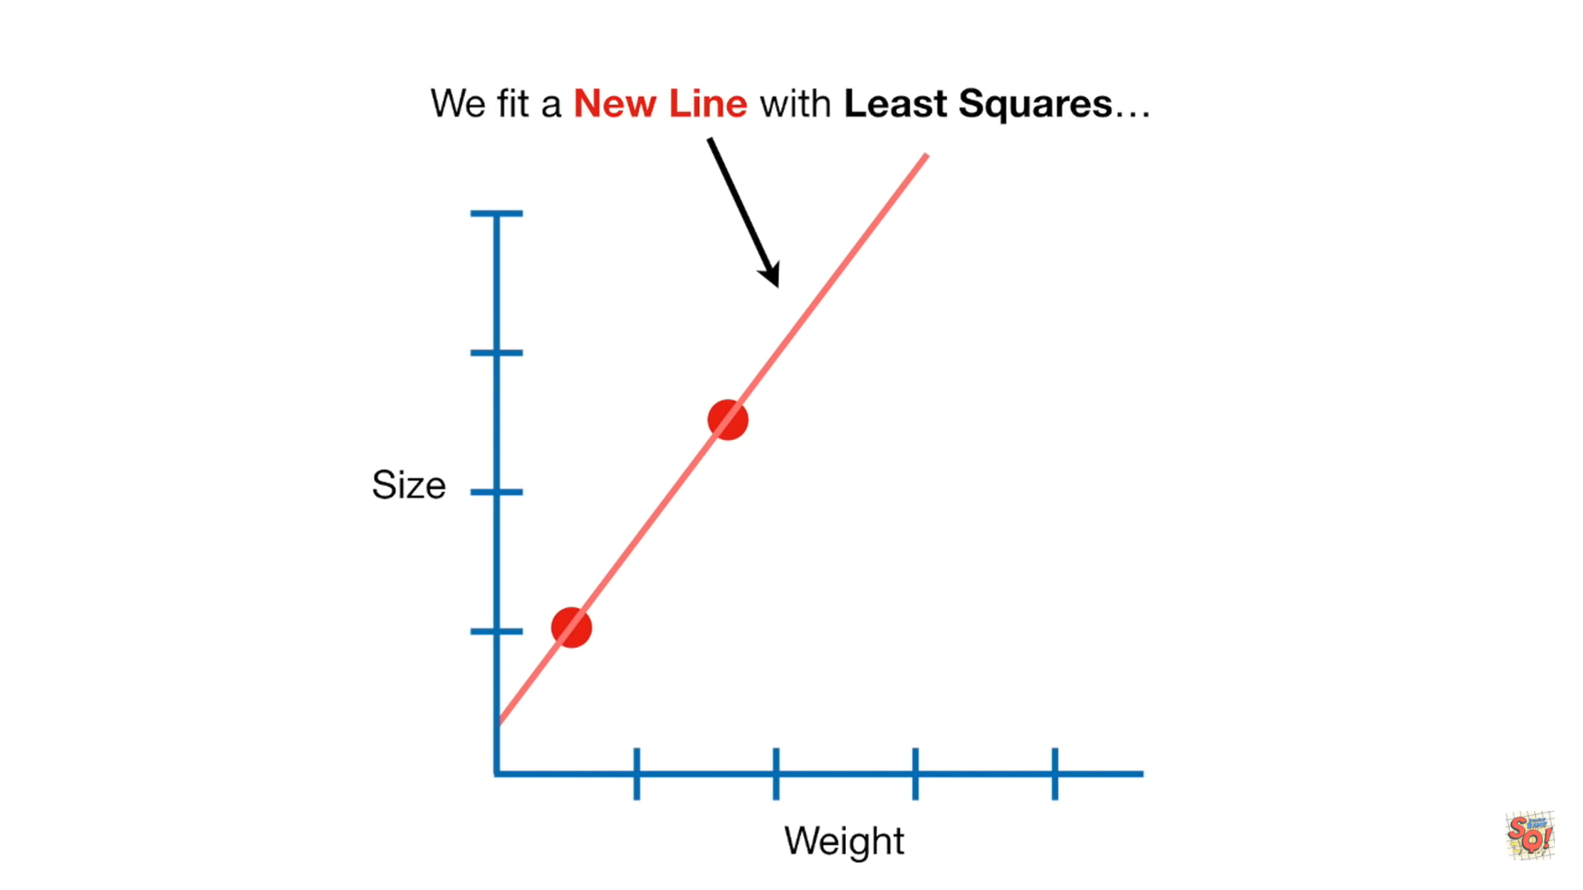
When we have a lot of measurements, we can be fairly confident that the Least Squares line accurately reflects the relationship between Size and weights.
But what if we only have two measurements?
We fit a new line with least squares
Since new line overlaps the two data point, the minimum sum of squared residuals = 0

Slide 10
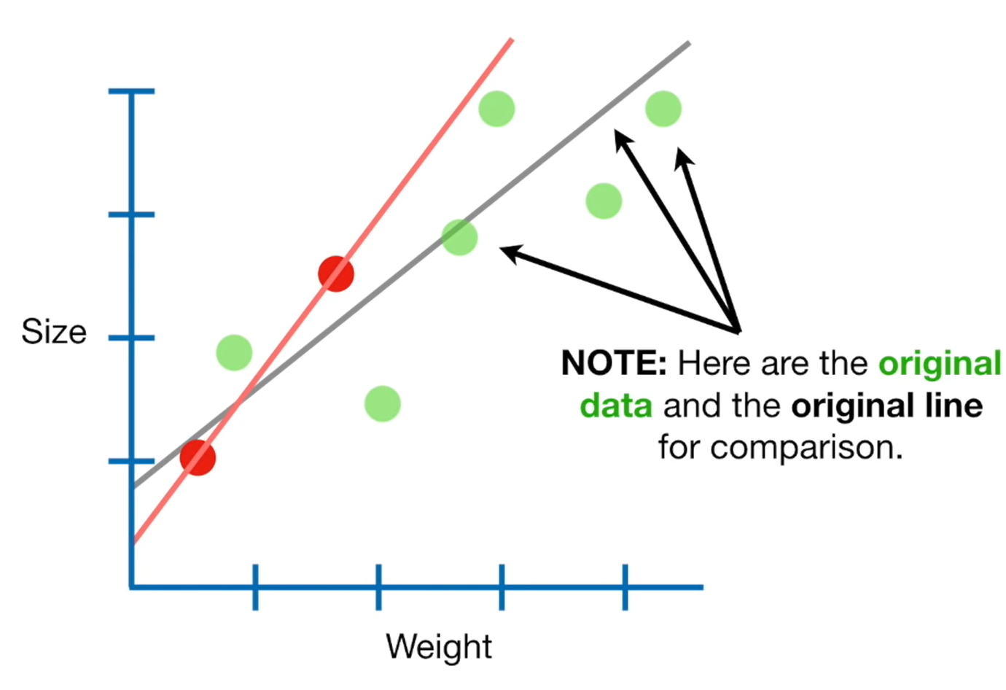

Slide 11
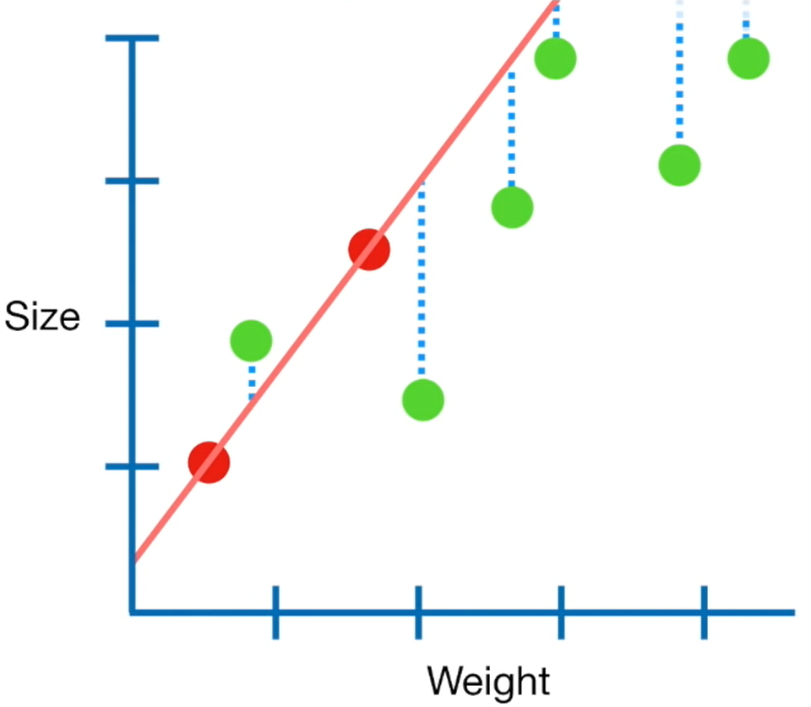
Let’s call the two red dots the training data , and the remaining green dots the testing data.
The sum of the squared residuals for just the two red points, the training data is small ( in this case it is zero)
But the sum of the squared residuals for the green points, the testing data is large.
And that means the new line has high variance.
In machine learning, we say that the new line is over fit to the training data.

Slide 12
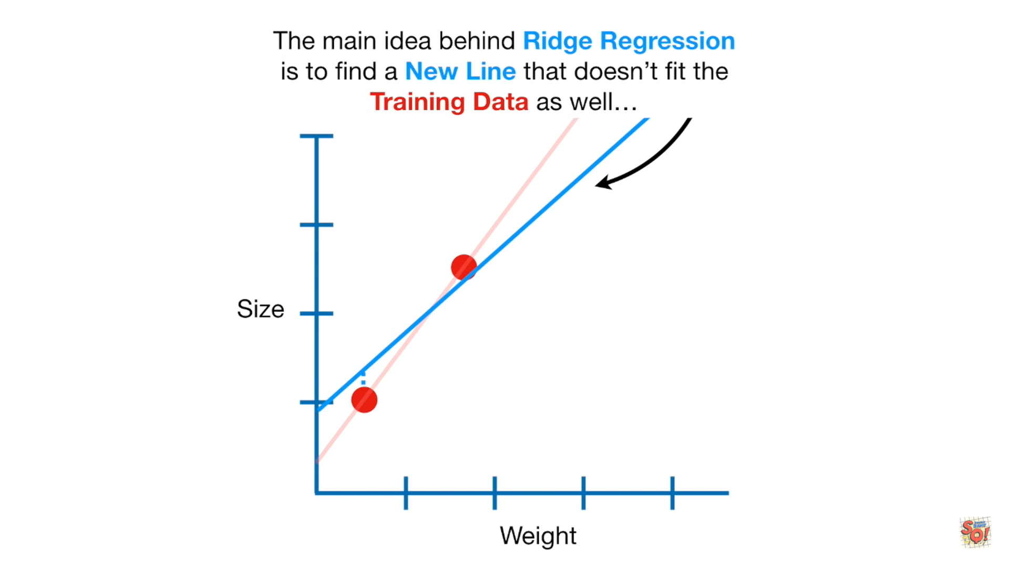
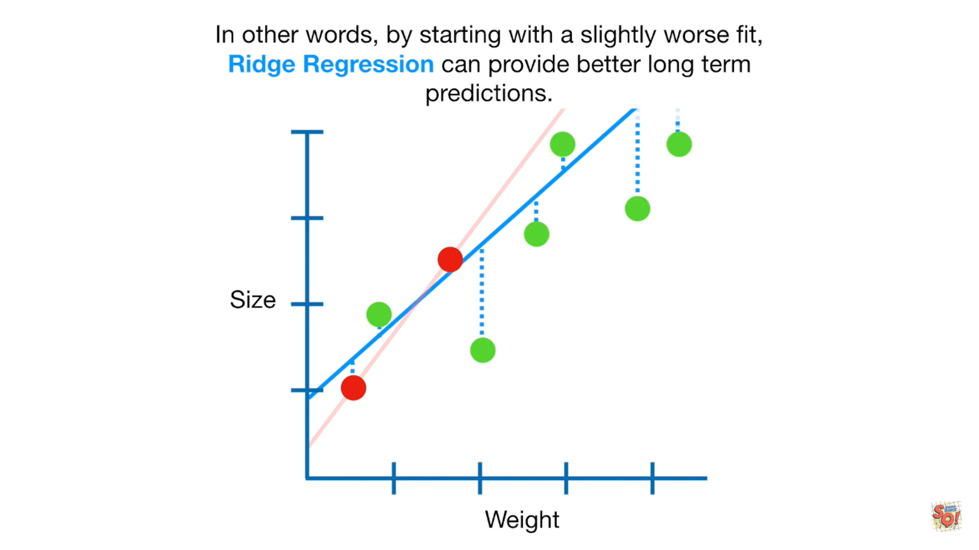
Now let’s go back to the training data.
We just saw that least squares results in a line that is over fit and has high variance.
The main idea behind RIDGE REGRESSION is to find new line that doesn’t fit the training data as well.
In other words, we introduce a small amount of bias into how the new line is fit to the data.
But in returns for the small amount of bias, we get a significant drop in variance.
In other words, by starting with a sightly worse fit, RIDGE REGRESSION can provide better long term predictions.

Slide 13
HOW RIDGE REGRESSION WORKS?
Let’s go back to training data.
When Least squared determines values for the parameters in the equations
Size= Y-axis intercept + slope x Weight
It minimizes the sum of the squared residuals
In contrast, when RIDGE REGRESSION determines value for the parameters in this equation
Size= Y-axis intercept + slope x Weight
It minimizes the sum of squared residuals + λ x slope^2
This part of the equation adds a penalty to the traditional Least Squares method
And Lambda determines how severe that penalty is.

Slide 14
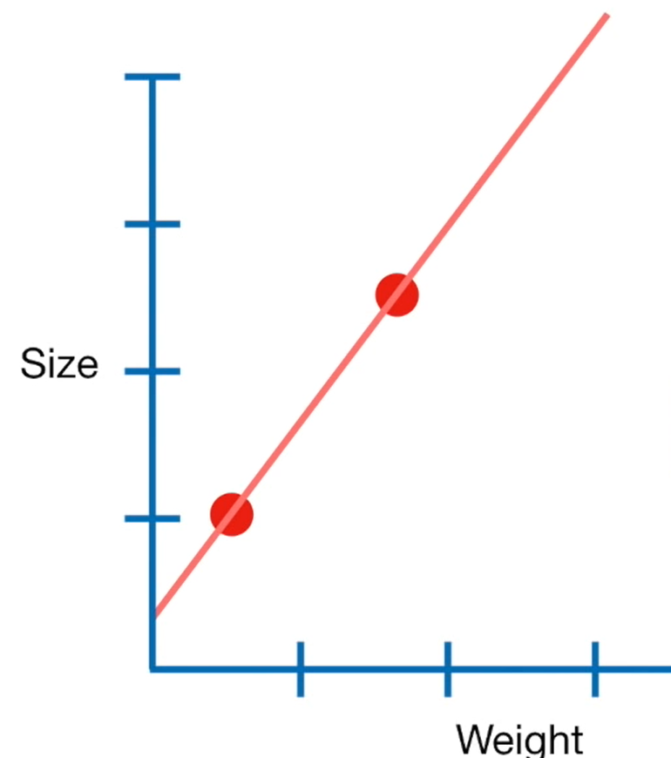
Example
Let’s start by plugging in the numbers that correspond to the least square fit.
Size= 0.4+ 1.3x Weight
the sum of the squared residuals + λ x slope^2
The sum of squared residuals for least squares fit is 0 (because the line overlaps the data point)
= 0 + λ x 1.3^2
Let λ = 1
= 0 + 1 x 1.3^2 = 0+1.69 = 1.69

Slide 15
Now let’s see what happens when we plug in numbers for ridge regression line
Size = 0.9 + 0.8 x Weight
the sum of the squared residuals + λ x slope^2
= (0.3^2 + 0.1^2 ) + λ x 0.8^2
Let λ =1
= 0.09 +0.01 + 0.64
= 0.74
0.1^2 for this residual
0.3^2 for this residual

Slide 16
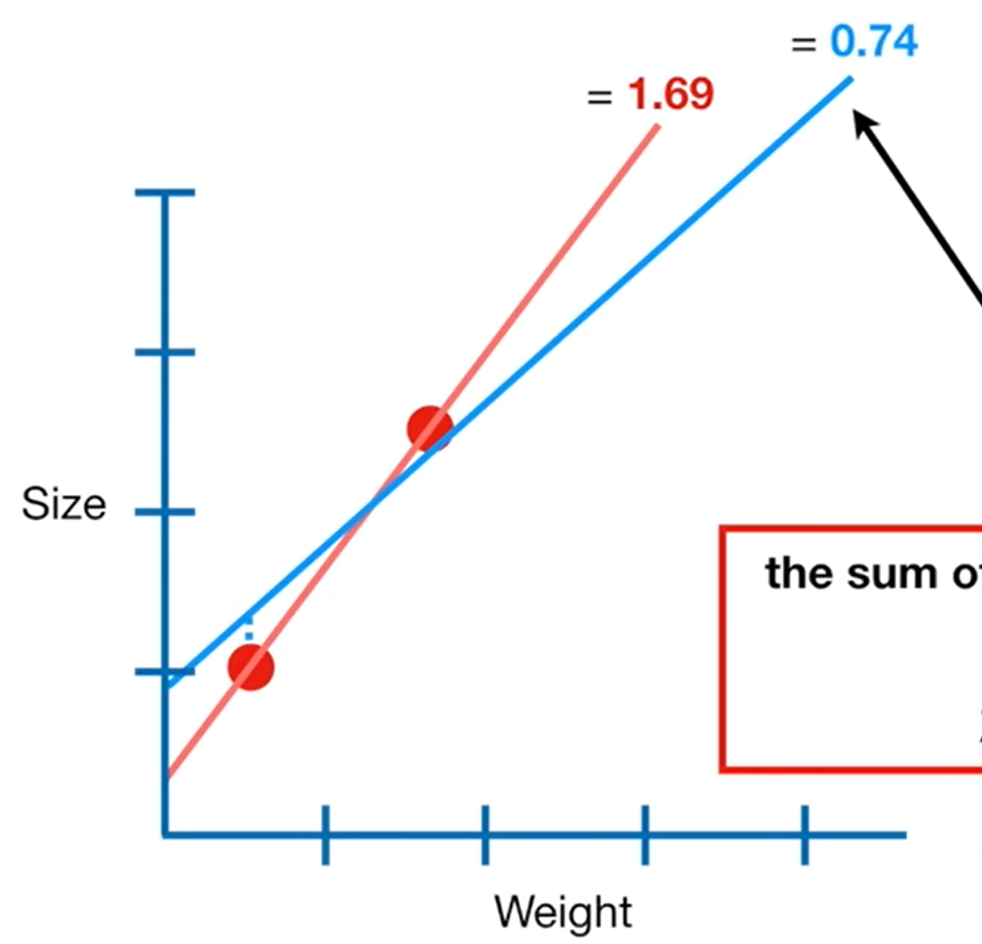
For the least squares line, the sum of squared residuals plus the ridge regression penalty is 1.69
For the ridge regression line, the sum of squared residuals plus the ridge regression penalty is 0.74
Thus, if we wanted to minimize the sum of the squared residuals plus the ridge regression penalty , we would choose the ridge regression line over the least squares line.

Slide 17
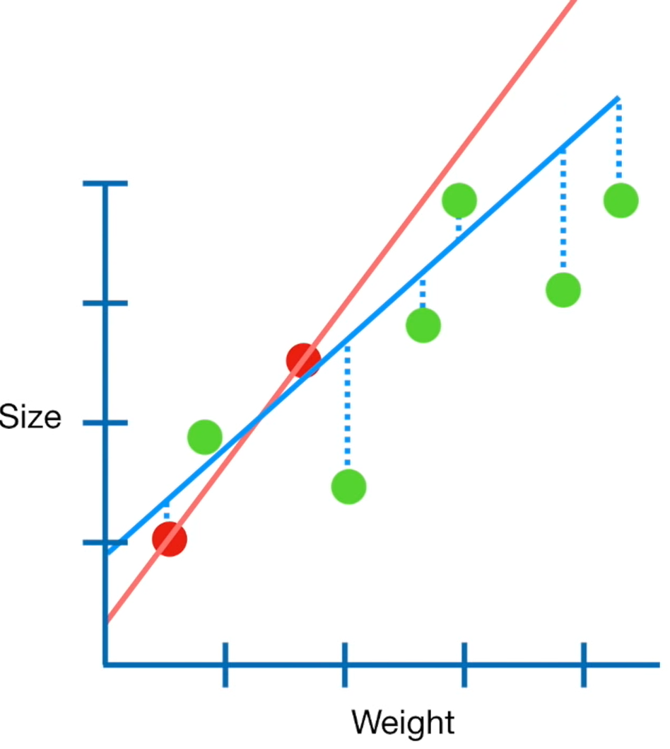
Without the small amount of bias that the penalty creates, the least squares fit has a large amount of variance.
In contrast, the ridge regression line , which has the small amount of bias due to the penalty, has less variance.

Slide 18
Now before we talk about lambda, let’s talk a little bit more about the effect that the ridge regression penalty has on how the line is fit to the data.
Let’s go back to least squared and ridge regression lines fit to the two data points.
The ridge regression penalty resulted in a line that has a smaller slope. Which means that predictions made with the ridge regression line are less sensitive to weights than the least squared line.

Slide 19

Now let’s go back to the equation that ridge regression tries to minimize and talk about λ
the sum of the squared residuals + λ x slope^2
λ can be any value from 0 to positive infinity.
When λ = 0, then the ridge regression penalty is also 0.
And that means that the ridge regression line will only minimize the sum of squared residuals and ridge regression line will be the same as the least squared line because they are both minimizing the exact same thing.

Slide 20
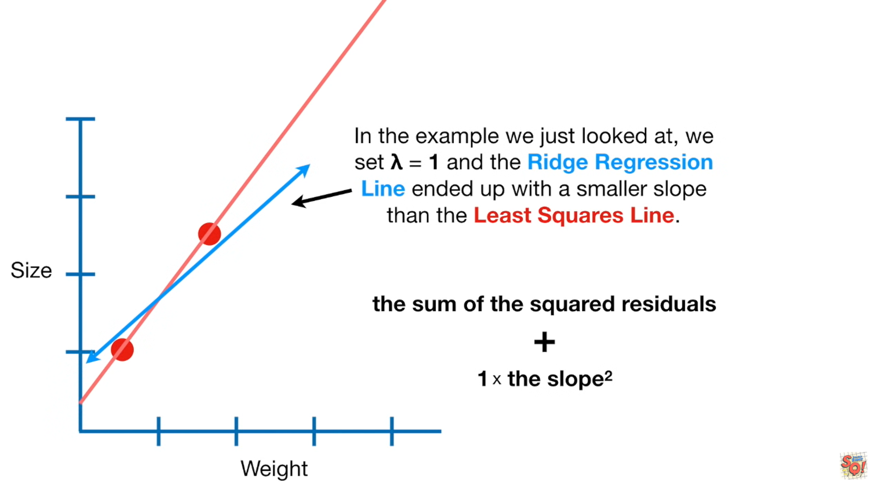
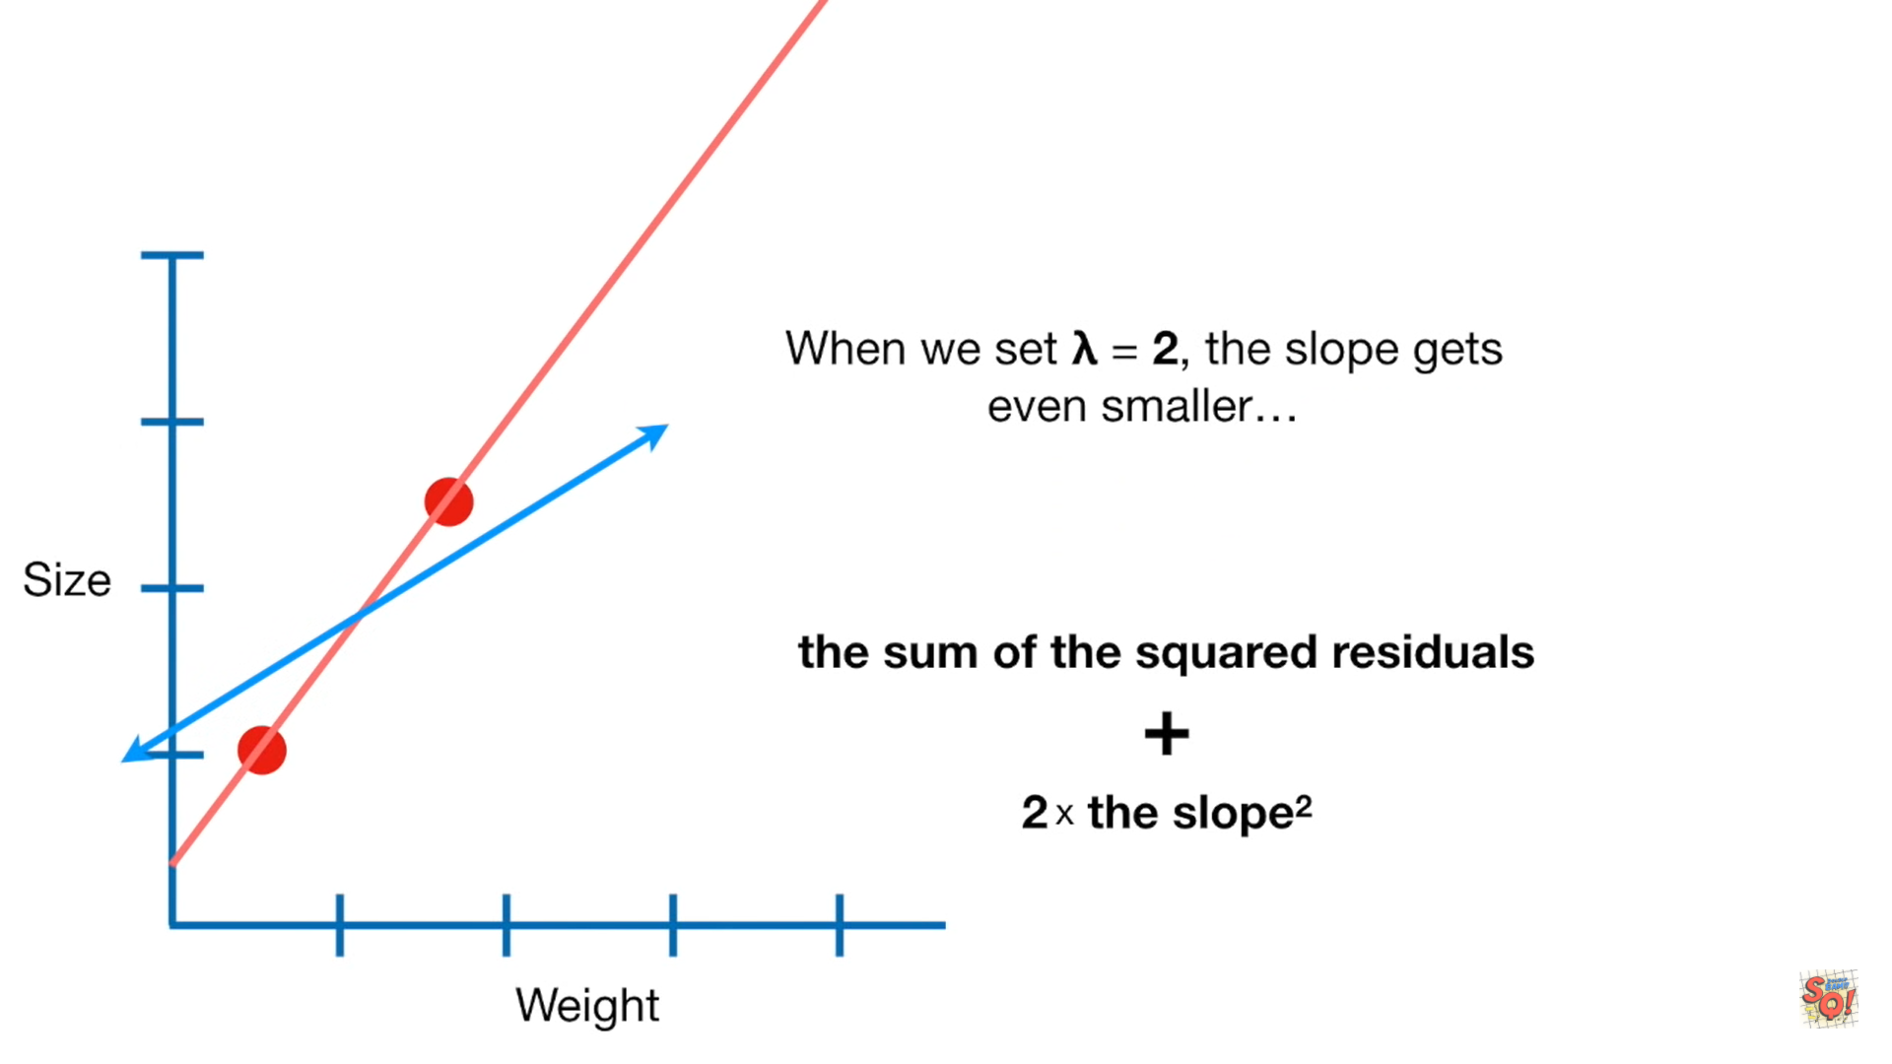
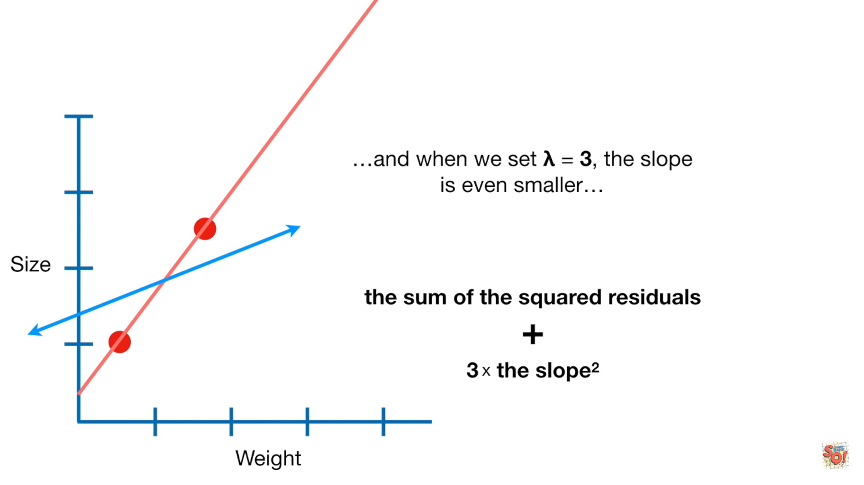
Now let see what happens as we increase the value for λ.
In the example we looked at, we set λ=1 and the ridge regression line ended up with smaller slope than least squared line.
When we set λ =2 , the slope gets even smaller and when we set λ =3 , the slope gets even more smaller
λ=2
λ=3
λ=1

Slide 21
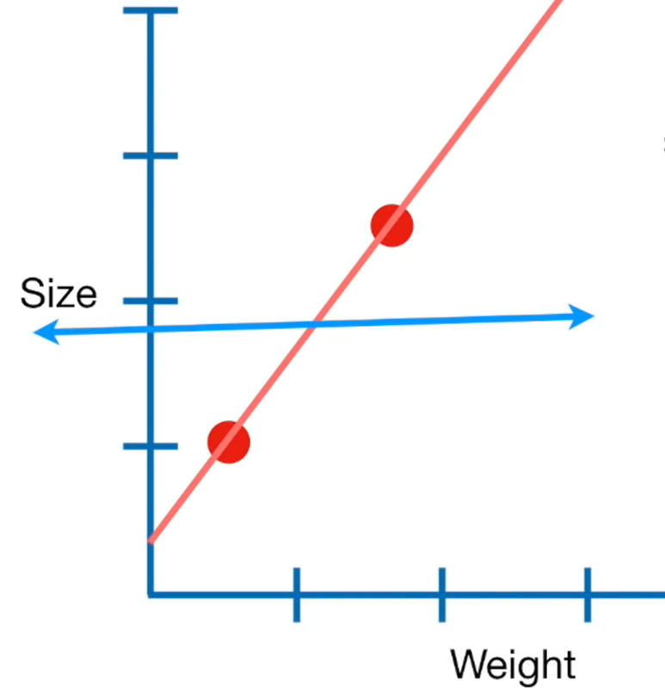
And the larger we make λ, the slope get asymptotically close to 0.
So larger λ gets, our predictions for size becomes less and less sensitive to weights.
the sum of the squared residuals + 100000 x slope^2

Slide 22
So how do we decide what value to give λ?
We just try a bunch of values for λ and use cross validation, typically 10-fold cross validation, to determine which one results in the lowest variance.

Slide 23
Summary
When the sample sizes are relatively small, the ridge regression can improve predictions made from new data (i.e. reduce variance) by making the prediction less sensitive to the training data.
This is done by adding the ridge regression penalty to the thing must be minimized the sum of the squared residuals + λ x slope^2
The ridge regression penalty itself is λ times the sum of all squared parameters, except for the y-intercept. And λ is determined using cross validation.
Lastly, even when there isn’t enough data to find the least squares parameters estimates, ridge regression can still find a solution with cross validation and the ridge regression penalty.

Slide 24
LASSO REGRESSION

Slide 25
The equation that ridge regression minimized and focus on the ridge regression penalty.
the sum of the squared residuals + λ x slope^2
If , instead of squaring the slope we take the absolute value, then we have lasso regression.
the sum of the squared residuals + λ x |slope|
Just like with ridge regression, λ can be any value from 0 to positive infinity and is determined using cross validation.

Slide 26
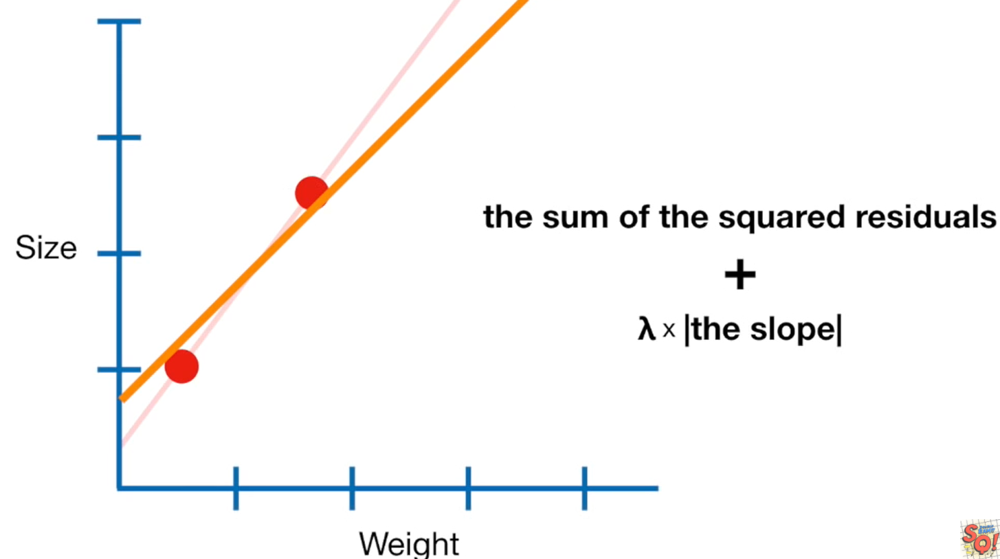
Ridge regression and lasso regression looks very similar and they do similar things.
To see what makes lasso regression different from ridge regression, let’s go back to the two sample training data. And let’s focus on what happens when we increase the value for λ.

Slide 27
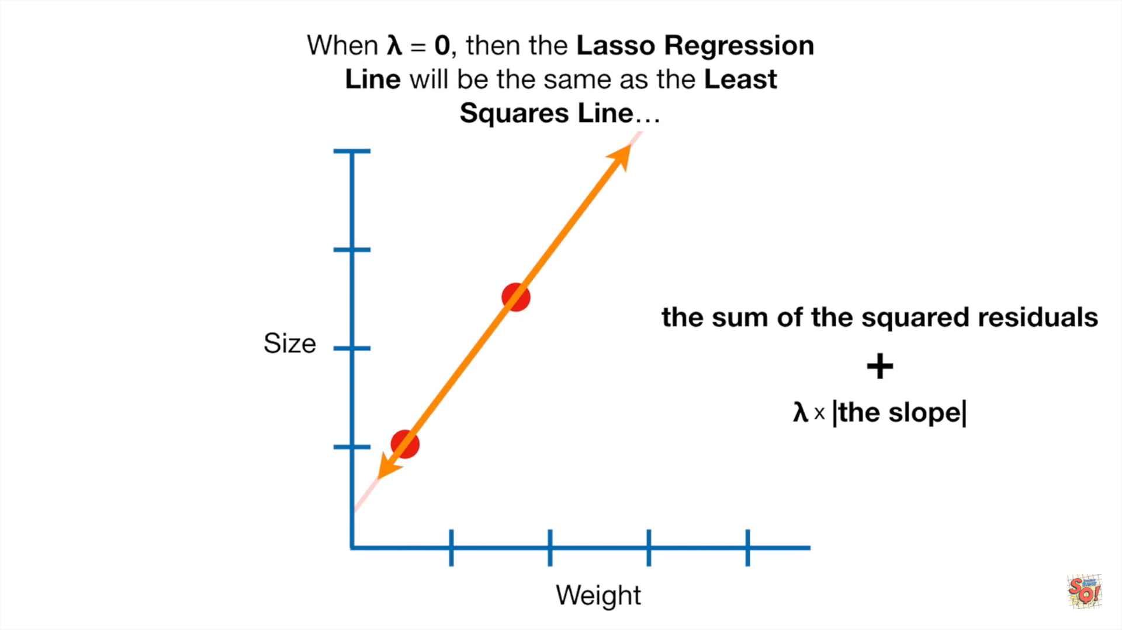
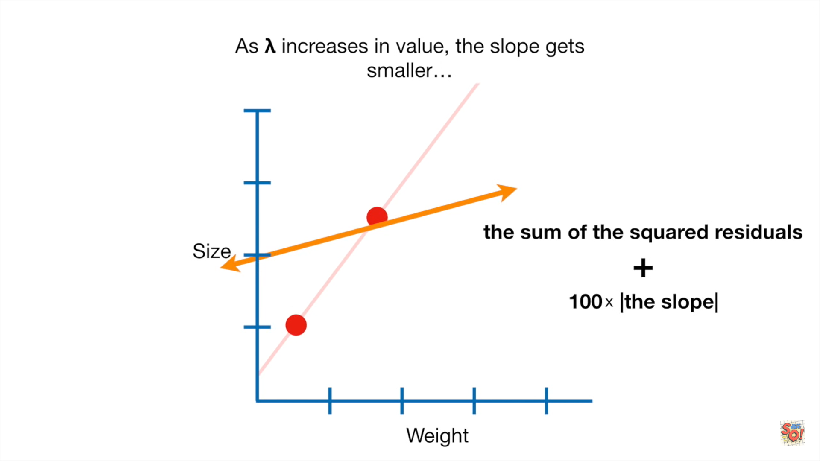
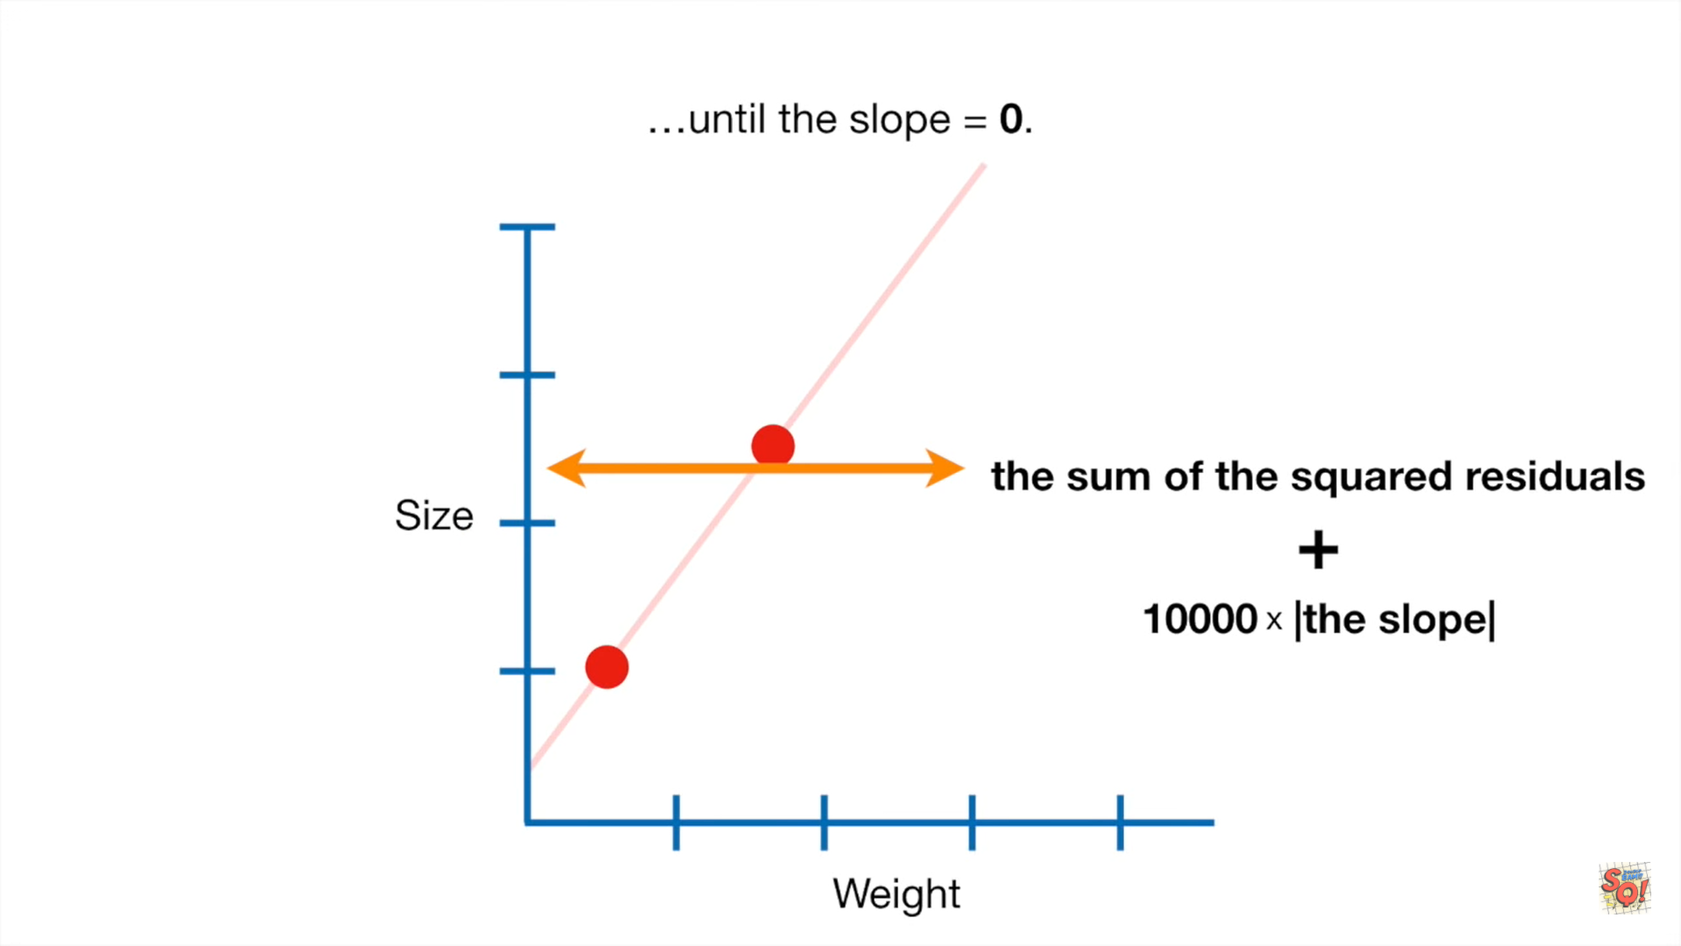
When λ=0, then the lasso regression line will be same as the least squares line.
As λ increases in value, the slope gets smaller until the slope = 0.
λ=0
λ=100
λ=10000

Slide 28
The big difference between ridge regression and lasso regression is that ridge regression can only shrink slope asymptotically close to 0 while lasso regression can shrink the slope all the way to 0.
To see this difference let’s look at this equation
Size = y-intercept + slope x Weight + diet difference x high fat diet + astrological offset x sign + airspeed scalar x airspeed of swallow
The goal of equation is to predict size.
The term weight and high fat diet, are reasonable things to predict size. But the astrological sign and the airspeed of swallow are terrible ways to predict size.

Slide 29
When we apply ridge regression to this equation, we find the minimal sum of squared residual plus the ridge regression penalty
λ x (slope^2 + diet difference^2 + astrological offset^2 + airspeed scalar^2)
And larger we make λ
Size = y-intercept + slope x Weight + diet difference x high fat diet +
astrological offset x sign + airspeed scalar x airspeed of swallow
These parameters might shrink a little bit
And these parameters might shrink a lot, but they never be equal to zero.

Slide 30
In contrast , with lasso regression
λ x ( |slope| + |diet difference|+ |astrological offset| + |airspeed scalar| )
When we increase the value for λ
Size = y-intercept + slope x Weight + diet difference x high fat diet +
astrological offset x sign + airspeed scalar x airspeed of swallow
And we’re left with a way to predict size that only includes weight and diet
Size = y-intercept + slope x Weight + diet difference x high fat diet
Then these parameters will shrink a little bit
And these parameters will go all the way to zero.
And these terms go away.

Slide 31
Since lasso regression can exclude useless variables from equation, it is a little better than ridge regression at reducing the variance in models that contains a lot of useless variables.
In contrast, ridge regression tends to do a little better when most variables are useful.

Slide 32
summary
Ridge regression is very similar to lasso regression
The superficial difference is that the ridge regression squares the variables and lasso regression takes the absolute value.
But the big difference is that lasso regression can exclude useless variables from equations. This makes the final equation simpler and easier to interpret.
the sum of the squared residuals + λ x slope^2
the sum of the squared residuals + λ x |slope|

Slide 33
THE importance of bias variance tradeoff
When designing a machine learning model for a dataset that is linearly separable it is important to ensure that it is properly optimized.
If the cost function has high variance then the model is overfit which causes wrong predictions for any new data with noise in it, if it has high bias then the model is underfit.
It is important to find the right balance between bias and variance to ensure the model is optimised and there is space for noise in the dataset for future data points.

Slide 34
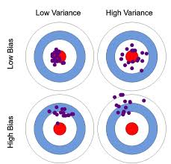

Slide 35
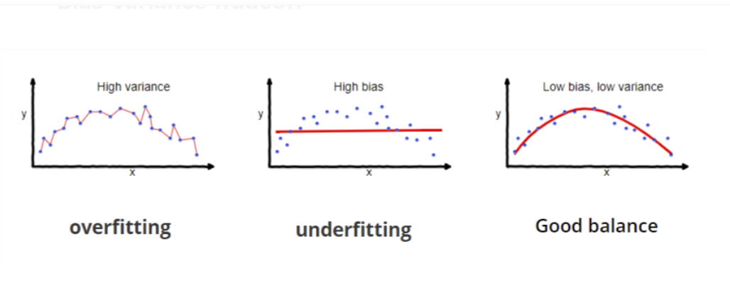
Effects of high low bias and variance

Slide 36
THANKYOU

